Slide 1

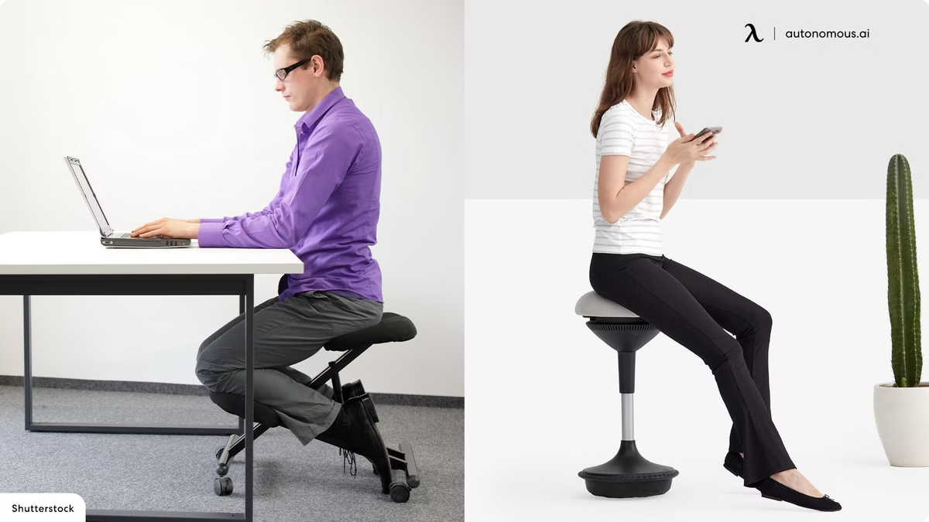

Comfy chair
Revolutionizing ergonomic seating with comfy Experience unparalleled comfort and support . Team member : Ahmed Mohamed Ebrahem Sayed , Mohamed Ahmed Mohamed ELabady , Shahd mosaad Elemam .

Slide 2

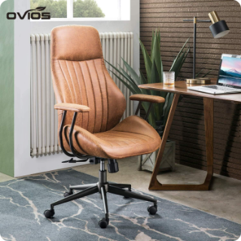

Introduction: our key benefits
Promotes upright posture
1
2
Enhanced Comfort
3
Improves Productivity
Reduces back pain and promotes healthy posture.
Provides superior comfort during prolonged sitting.
Boosts focus and reduces discomfort.

Slide 3

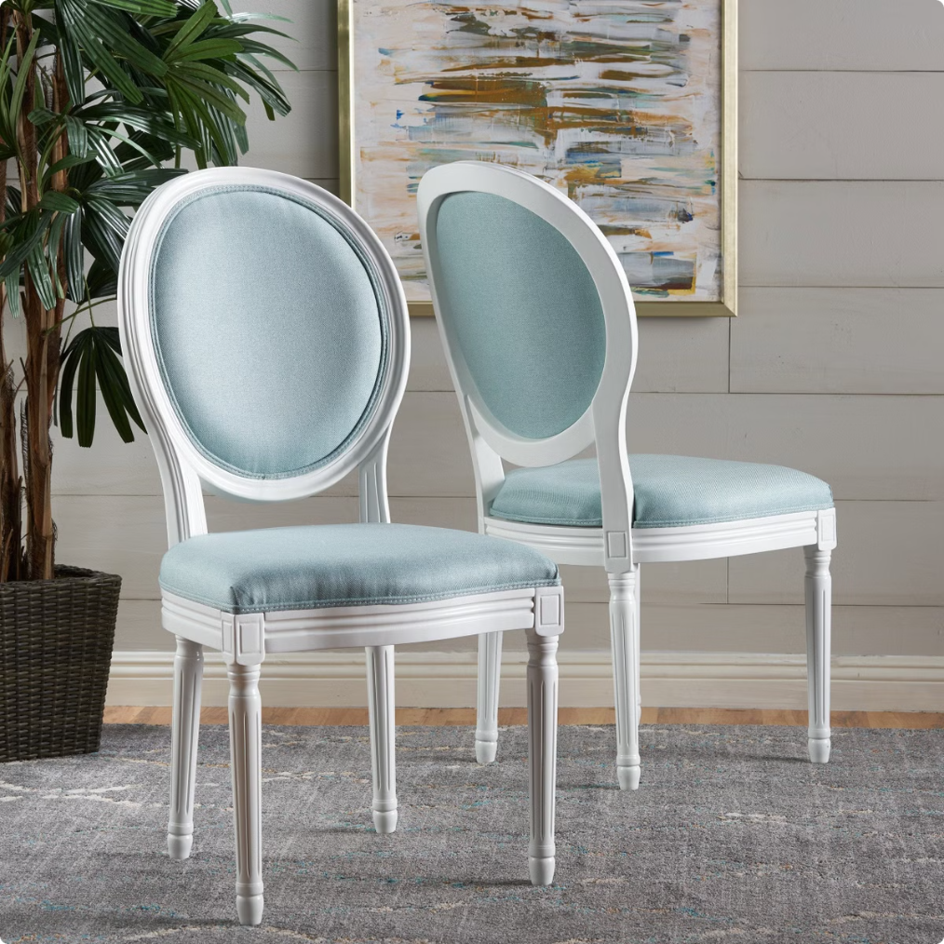



Key Features
U-Shaped cushion
Offers targeted support to the lower bask.
Eco friendly materials
Ensure recycle and sustainable materials.
Active sitting
Facilitates dynamic movement while seated.

Slide 4

Pain points
Poor posture
Back and leg pain
Discomfort during long hours
Addresses the discomfort and health issues associated with prolonged poor posture .
Offers relief and support for users experience discomfort in these ereas
Provides ergonomic support to reduce strain and discomfort during extended sitting periods
.

Slide 5

Unique selling points (UPSs)
Quality of materials
versatility
Customer satisfaction
Addresses the discomfort and health issues associated with prolonged poor posture .
Suitable for various work invironments.
Positive testimonials highlight its effectiveness and comfort.

Slide 6

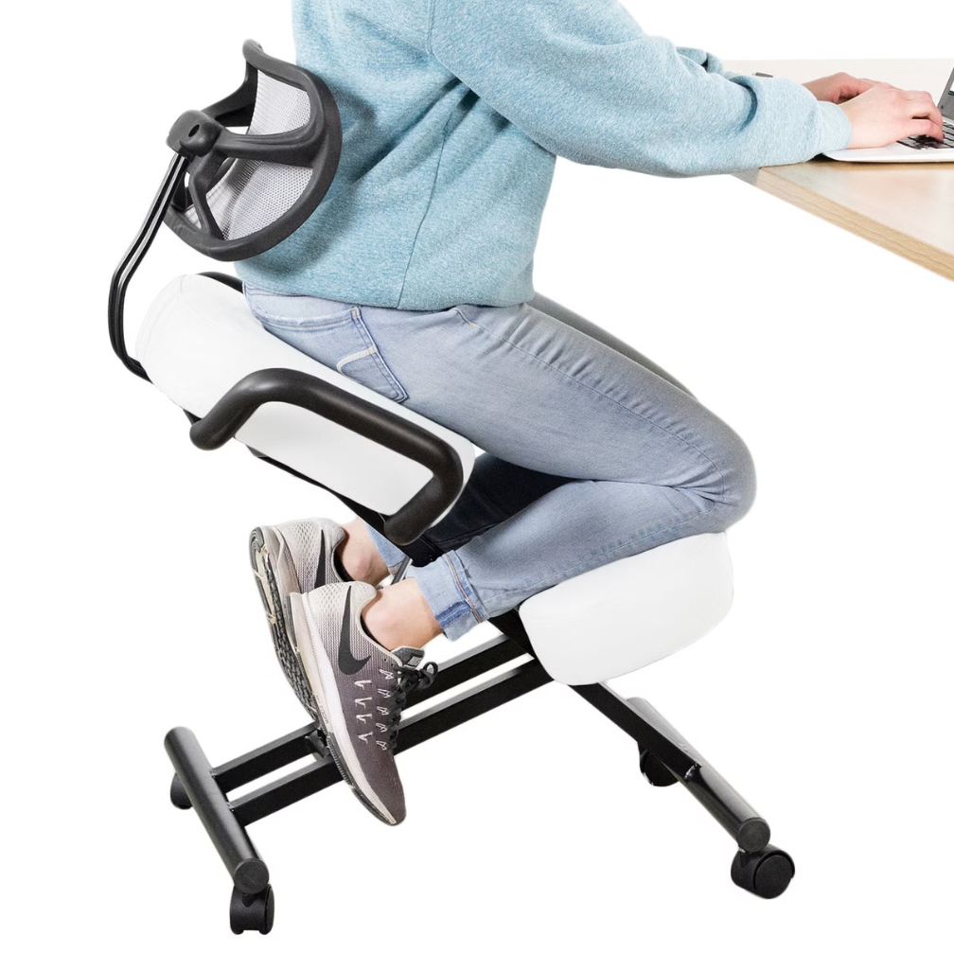



Competitive advantages
Superior Comfort
The cushion adapts to the body shape, while the ergonomic design promotes proper alignment .
Unique active sitting technology
We combines the benefits of ergonomic support with the advantages of movement , this feature sets it apart from traditional static chairs and added value to customer .
Versatile
This versatility ensures a comfort and personalized sitting experience.

Slide 7
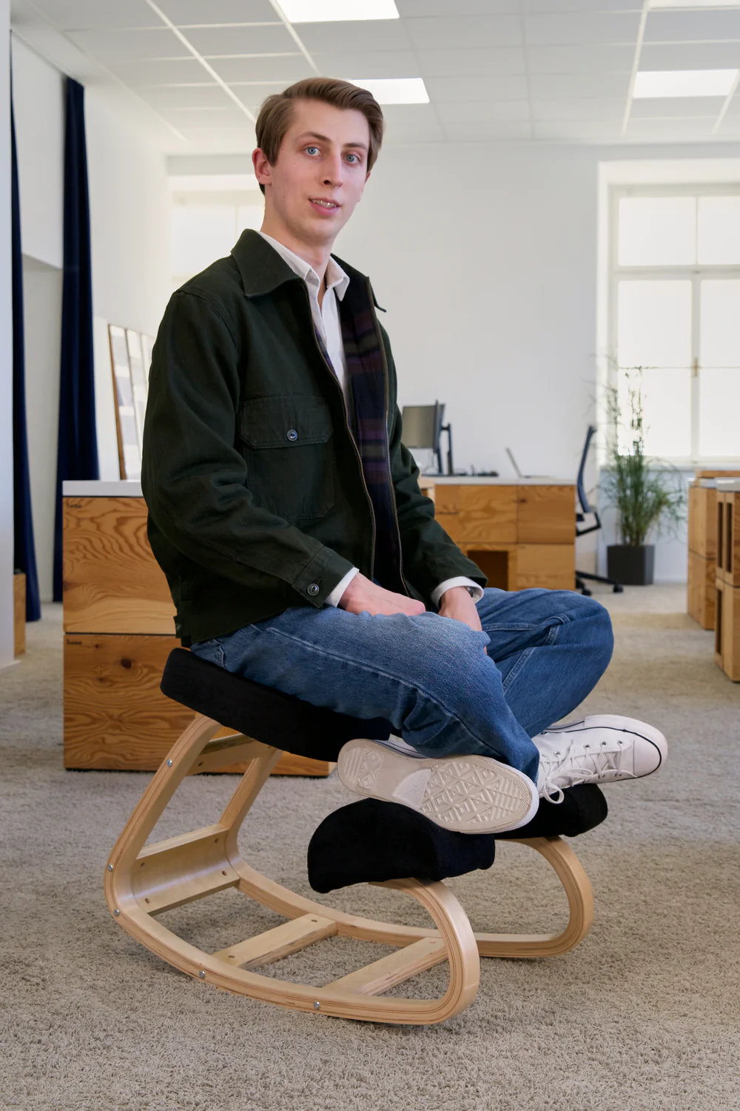

Brand mantra
Raise your efficiency
Enhance your comfort
.

Slide 8

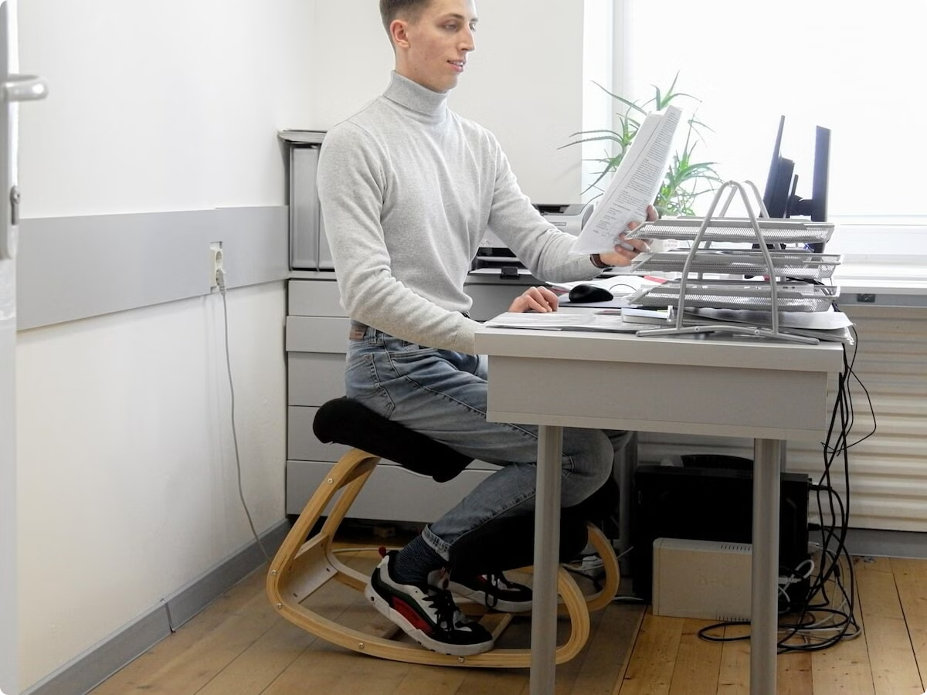

Brand positioning
To: struggles with maintain posture and comfort during long hours at the computer
Comfy chair consumer furniture
That:
Improve posture
Reduce back and nick pain
Eco friendly and sustainable
Durable and comfortable
Because:
Relieves lower back pressure
Engaging core muscles
Relieves disc stress
Lightweight and portable

Slide 9

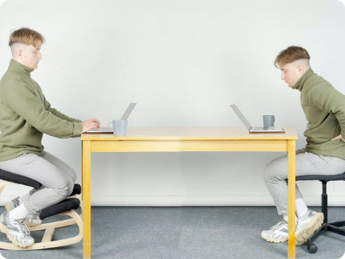

Target Customer Personas
Remote and hybrid Workers
Students
Need for posture support.
Long study sessions.

Slide 10

Niche (1): remote and hybrid workers
demographics
Age | Gender | Income level | Education | marital
35-45 | Male or female | Middle or upper middle ($5000-8000) | Collage educated , with degree in business, technology, or creative field | Married, with or without childrens
Psychographics
Lifestyle
personality
motivations
Health conscious employees who prioritize their physical well-being
Practical, detailed oriented, and eager to adopt innovation products
Driven to find effective solutions for improving posture
Pain points
Physical health
Work life balance Ergonomic confusion
productivity

Slide 11

Customer journey for remote and hybrid workers

Slide 12

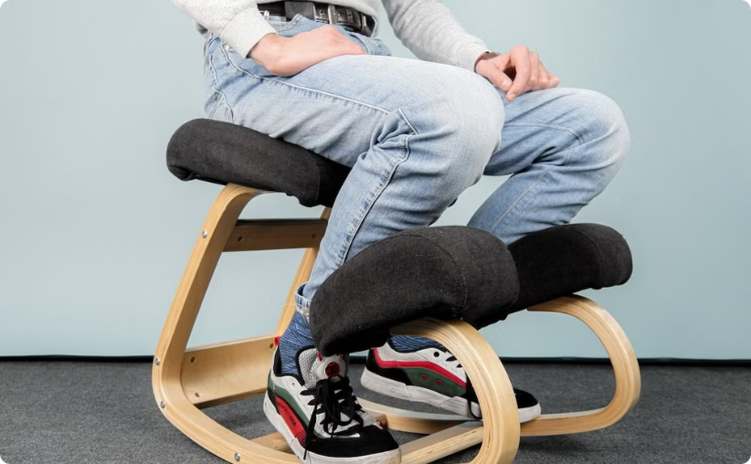
Niche (2):collage students
demographics
Age | Gender | Income level | Education | marital
18-24 | Male or female | Limited income, reliant on part time jobs or family support ($500-1000) | Currently in collage | Single, some in relationships
Psychographics
Lifestyle
personality
motivations
Health conscious employees who prioritize their physical well-being
Practical, detailed oriented, and eager to adopt innovation products
Driven to find effective solutions for improving posture
Pain points
Physical health
Work life balance Ergonomic confusion
productivity

Slide 13
Niche (2): collage students
Geographic location
Saudi arabia, Bahrain, Qatar
------------------------------------------------------------------------------------------------------------------------------------------------------
Professional background
1-occupation: full time student, some with part time jobs (freelancing, retail, tutoring)
2-industry: diverse field of study like business,technology, arts, health science
3-work invironment: at home
-----------------------------------------------------------------------------------------------------------------------------------------------------
Media consumptions
Social media | Online communities | Search engines | Content interests

Slide 14
Customer journey for college student

Slide 15
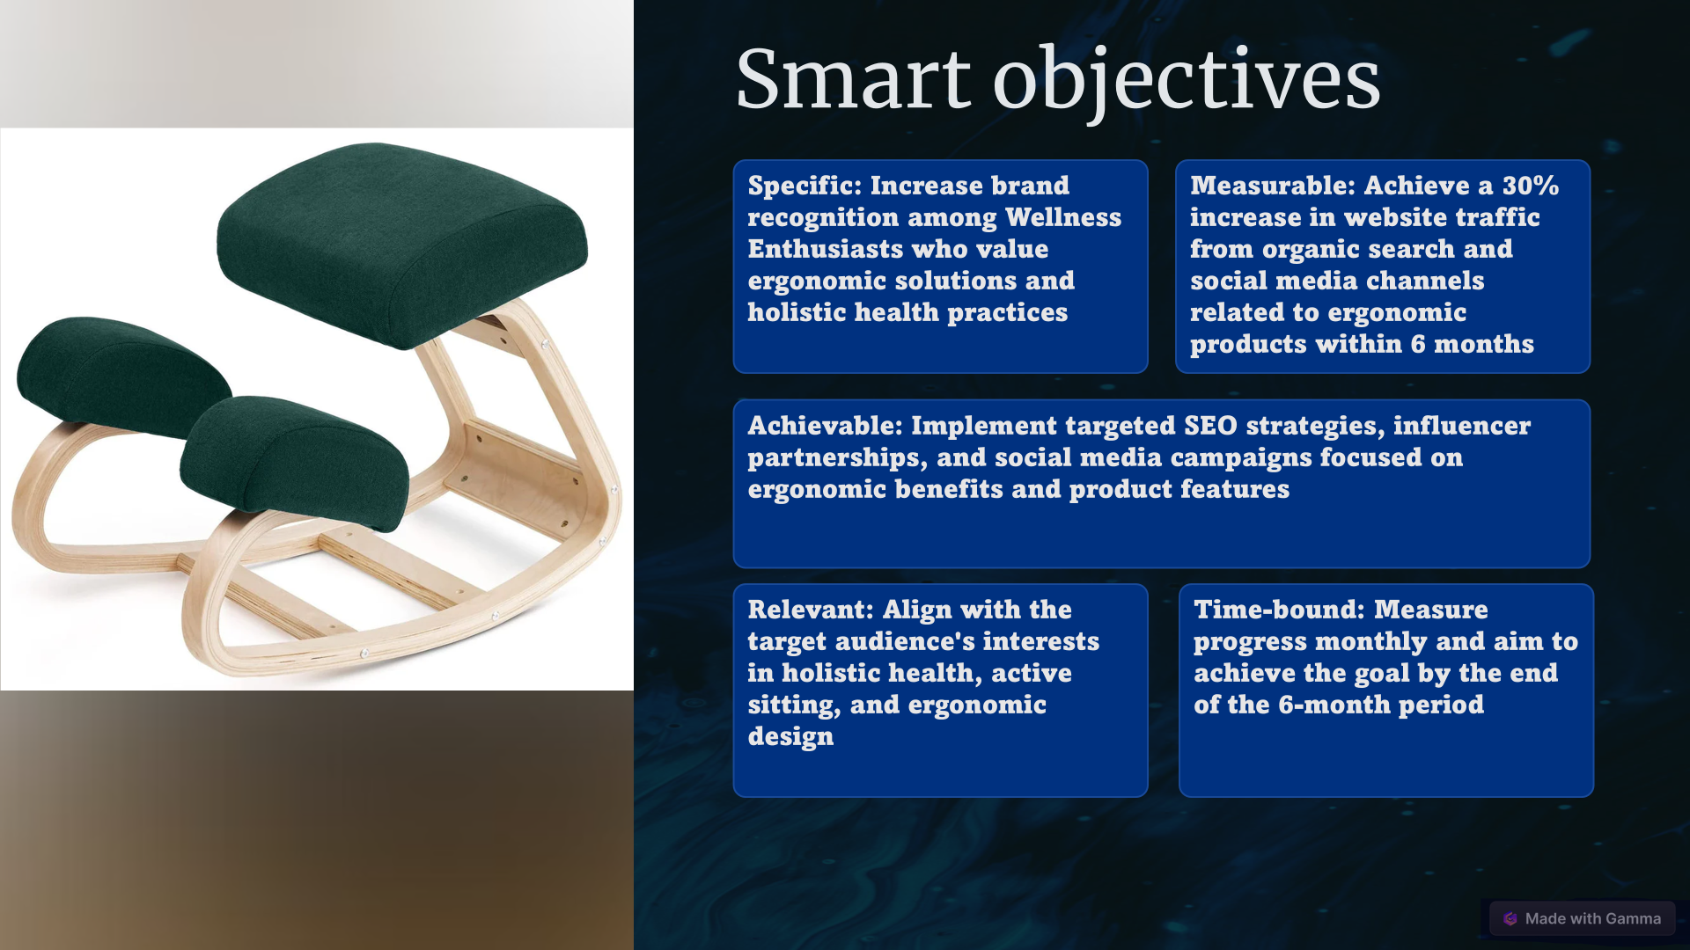


Slide 16
SWOT analysis
strengths | Weaknesses
Ergonomic benefits: promote better posture Increased productivity: by reducing pain Growing health awareness: rising awarenass of ergonomics and healthy work | Limited user base: kneeling chairs may not be suitable for everyone Price point: compared to standard chair, kneeling chairs can be more expensive need for user education: not everyone is familiar with kneeling chair benefits
opportunities | threats
Online marketing and sales: leveraging digital platforms like VILNO.CO to reach wider audience Health and wellness trend: growing emphasis on health and well being | Ergonomic alternatives: standing desks or other ergonomic furniture options could pose competition Economic downturn: in eco downturn business and consumers might prioritize lower cost furniture options

Slide 17
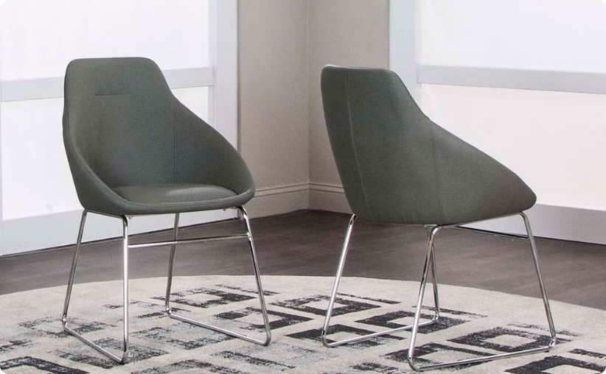
Pricing, Packaging, and Distribution Plan
Packaging
Distribution
Attractive and protective.
Online and plan to retail channels.

Slide 18


Multichannel Marketing Strategies
1
Social Media platforms
Snapchat-instgram –tik tok
2
Target audience
Saudi arabia
3
Content Marketing
Blog posts, videos, and infographics.

Slide 19
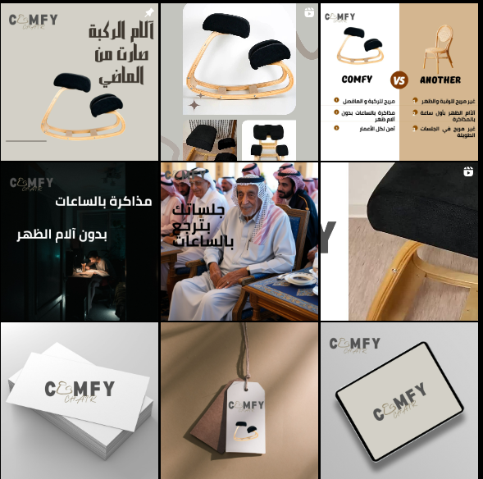
instgram

Slide 20
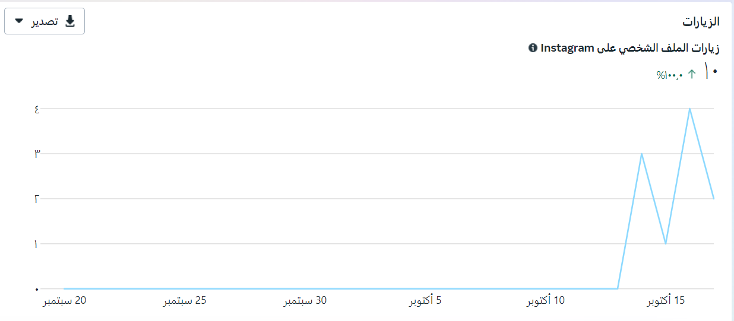
instgram

Slide 21
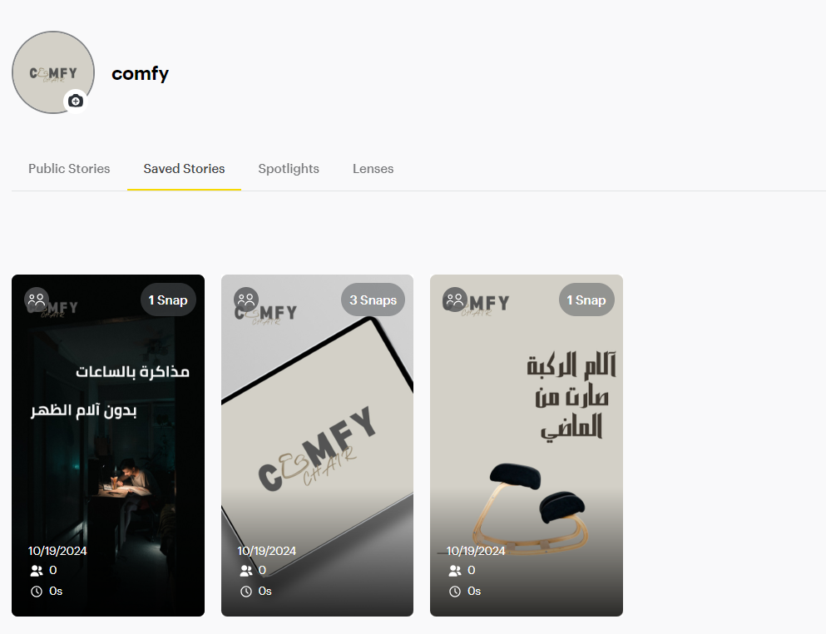
snapchat

Slide 22

TIK TOK

Slide 23
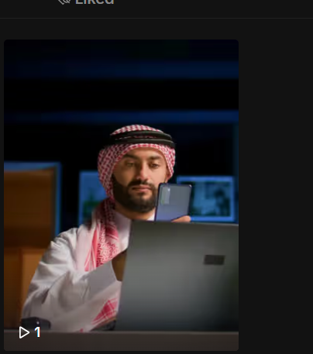
Story telling
https://www.tiktok.com/@comfy__chair/video/7425769445701766408?is_from_webapp=1&sender_device=pc&web_id=7410344342752495110
Pixar model

Slide 24
كان هناك عجوز سعودي يدعى أبو سلطان، يحب حضور المجالس ولقاء أصدقائه. لكن مع تقدم العمر، أصبحت آلام المفاصل تمنعه من الاستمتاع بهذه اللقاءات الطويلة.
يوماً بعد يوم، بدأ أبو سلطان يتجنب الذهاب إلى المجالس، خوفاً من الألم الذي سيشعر به. حتى أنه بدأ يشعر بالعزلة والحزن لابتعاده عن أحبائه.
في أحد الأيام، سمع أبو سلطان من حفيده عن كرسي جديد مصمم خصيصاً لكبار السن في المجالس السعودية. شعر بالفضول والأمل، لكنه كان متردداً في تجربة شيء جديد.
بعد إلحاح من عائلته، قرر أبو سلطان أخيراً زيارة المجلس الذي يحتوي على هذا الكرسي الخاص. وهناك، جلس على الكرسي بحذر، متوقعاً الألم المعتاد.
لدهشته، مرت الساعات وهو جالس دون أي شعور بالألم. استطاع أبو سلطان الاستمتاع بالحديث مع أصدقائه، والضحك، وتناول القهوة دون الحاجة للتحرك بسبب عدم الراحة.
منذ ذلك اليوم، أصبح أبو سلطان من أكثر رواد المجلس حماساً. عاد إلى عاداته القديمة في لقاء الأصدقاء، وحتى أنه بدأ في دعوة أصدقائه المسنين لتجربة الكرسي الخاص. أصبح أبو سلطان يشعر بالشباب مجدداً، مدركاً أن التكنولوجيا الحديثة يمكنها أن تتناغم مع التقاليد لتحسين حياة الجميع
Story telling
Pixar model

Slide 25
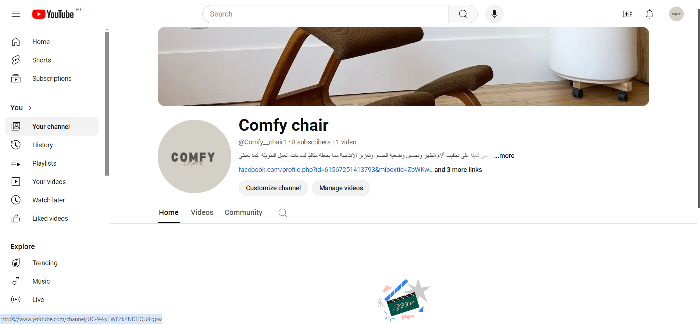
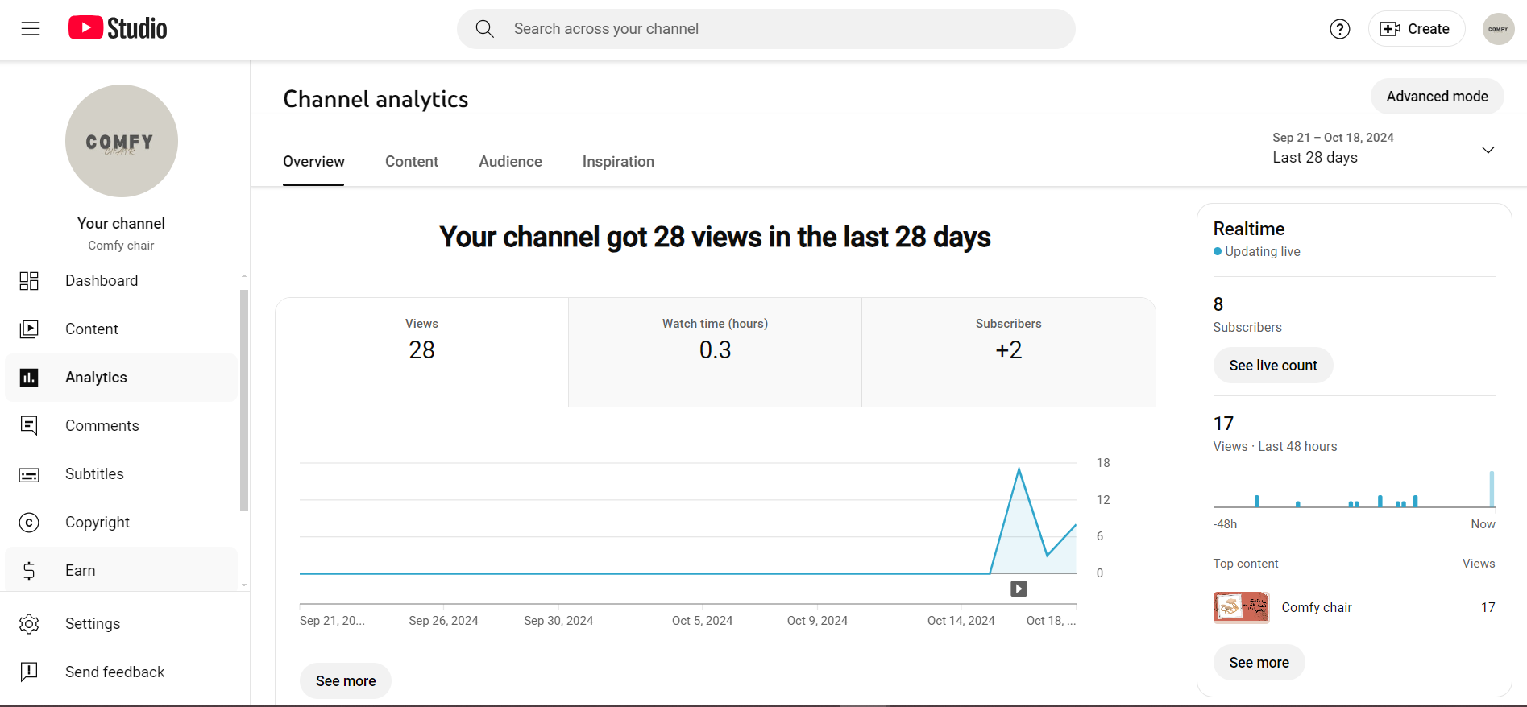
You Tube
You Tube

Slide 26
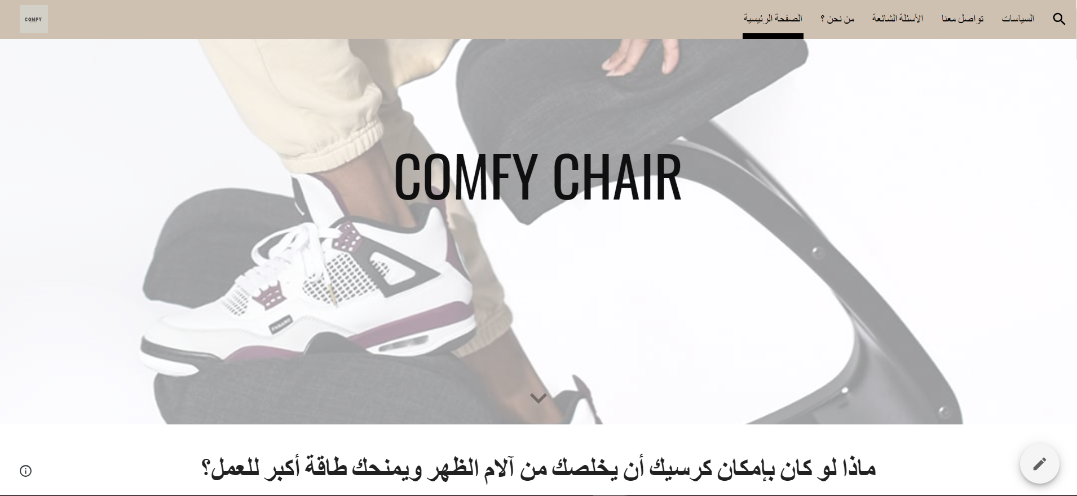
Google Sites
website

